Slide 1
Big Mountain Resort
Guided Capstone

Slide 2
Problem Identification
“What opportunities exist for Big Mountain to appropriately price its tickets this upcoming ski season by determining the existing and potential value of its facilities?”
350K visitors during ski season
Tickets are currently $81, valued above market average
Scope is determining facility changes that will warrant an overall ticket price increase.

Slide 3
Recommendations
Invest in building an additional ski run in order to visibly support a $2 price increase ($81 to $83)
Our pricing model supports up to a $15 price increase
this recommendation allows for a more gradual approach

Slide 4
Modeling Results
Shortlist of modeling scenarios are:
Decrease price - Permanently closing down up to 10 of the least used runs.
Increase the vertical drop
Increase the vertical drop and add 2 acres of snow making cover
Increase the longest run by 0.2 mile
Random Forest Regressor used to determine which features visitors value in terms of ticket price.

Slide 5
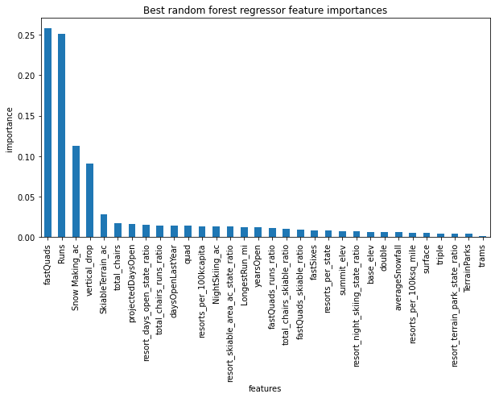
Determined that the amount of ski runs influence what a visitor is willing to pay for.

Slide 6
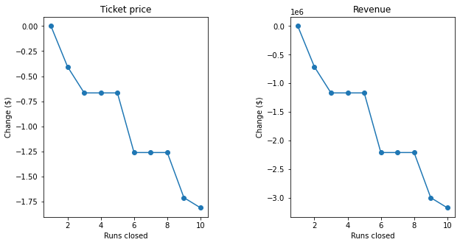
Determined that decreasing runs leads to decreased revenue.

Slide 7
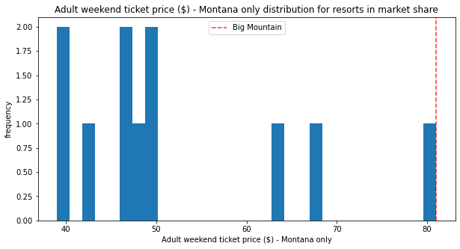
Summary
Using a $83 ticket price for the upcoming season is predicted to translate into $3.4 million in revenue.
Big Mountain can still stand to increase their ticket price up to $95 in subsequent seasons. A gradual approach was recommended as Big Mountain’s price already exceeds that of other Montana resorts.

